Slide 1
Application of the A* Algorithm to Solve the Longest Common Subsequence from Fragments Problem
Created by：Chiu-Ting Tseng
Date：Oct. 6, 2005

Slide 2
Abstract
Finding longest common subsequence (LCS) is a common problem in Biology informatics. The problem is defined as follows: Given two strings X=x1x2…xm and Y=y1y2…yn, find a common subsequence L=l1l2…lp of X and Y such that p is maximized. In this thesis, we discuss a variation of the LCS problem – LCS from fragments problem defined as follows: Given two strings X and Y and a set M of fragments which are matching substrings of X and Y, find a LCS from M. A new method using a tree searching strategy, A* algorithm, is proposed in this study for the LCS from fragments problem. The method can help us to filter out some fragments which wouldn’t appear in solutions, and efficiently find a solution. However, in worst cases, all fragments are needed to be computed in the solving process.

Slide 3
Longest common subsequence from fragments problem
Given two strings X and Y and a set M of fragments of X and Y, find a longest common subsequence of X and Y from M.
First proposed in “Sparse Dynamic Programming for Longest Common Subsequence from Fragments, Baker, B. S. and Giancarlo, R., Journal of Algorithms, Vol. 42, 2002, pp. 231-254. ”

Slide 4
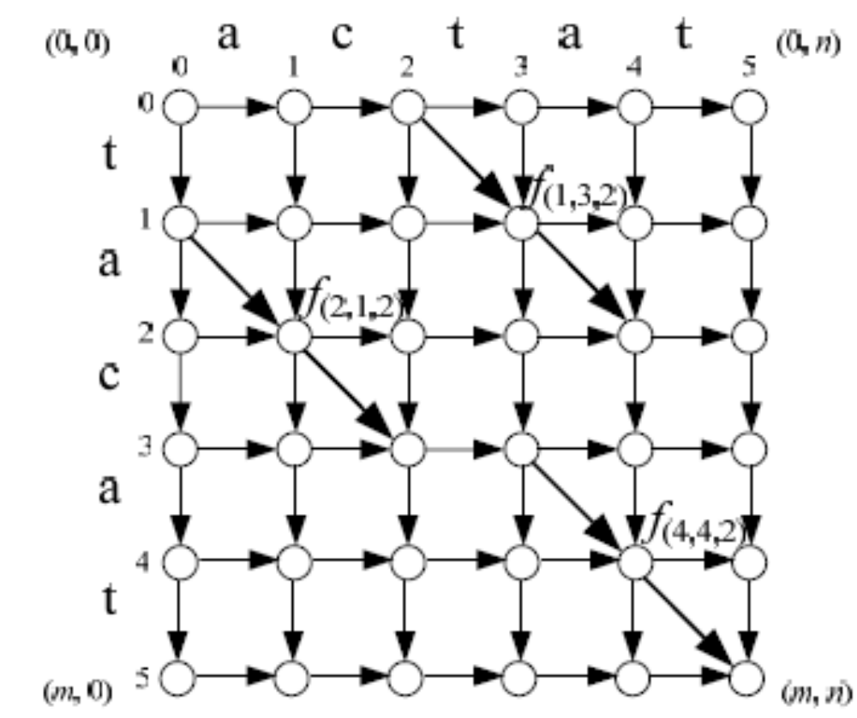
Example(1)

Slide 5
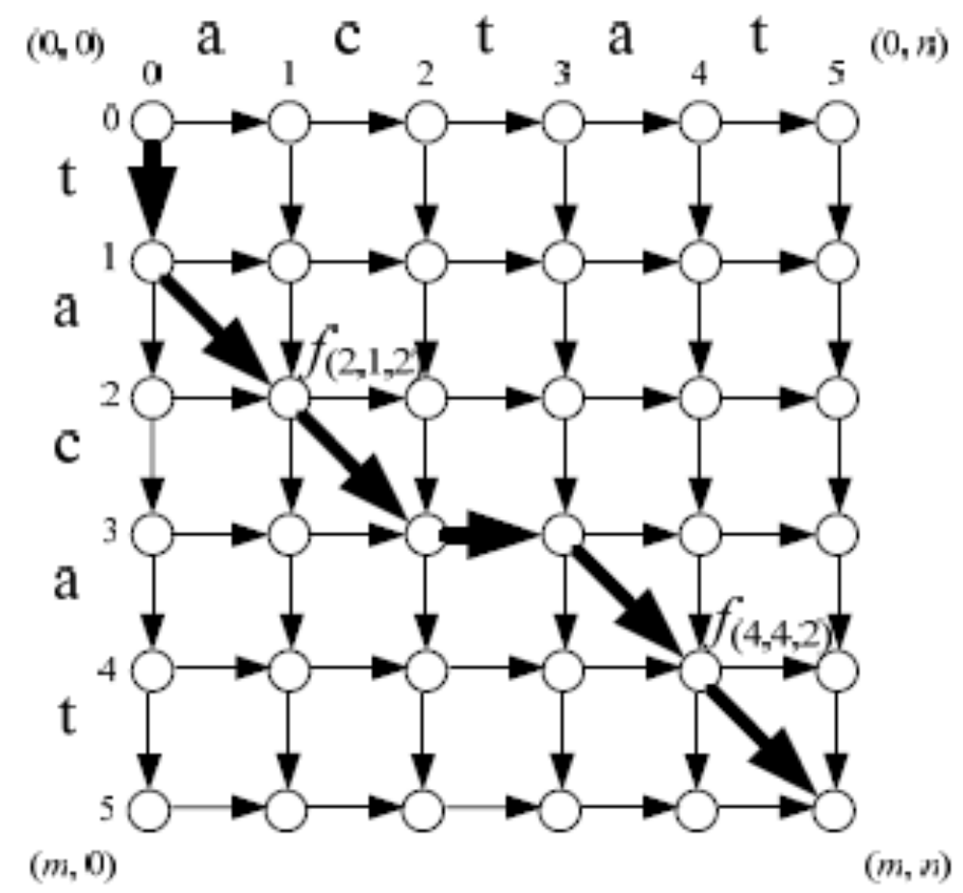
Example(2)

Slide 6
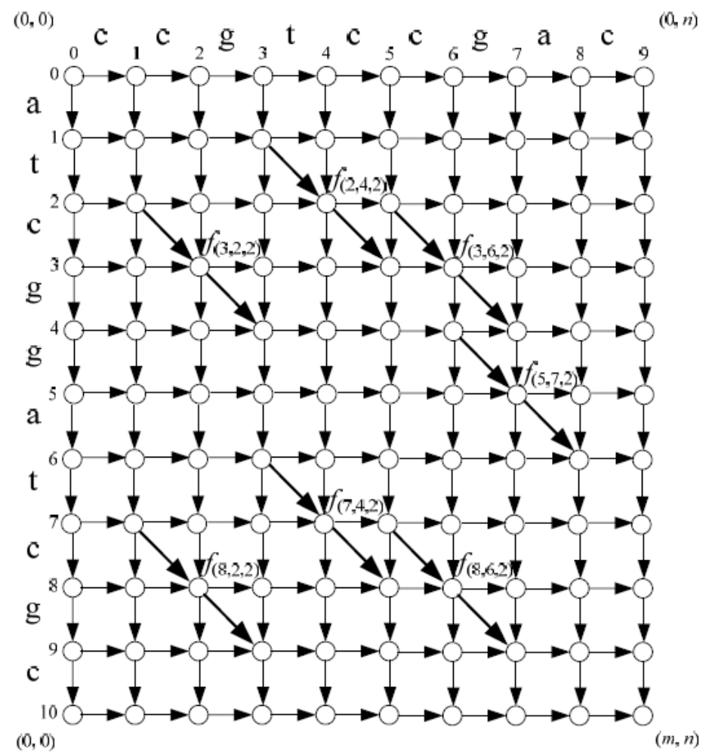
Baker-Giancarlo Approach(1)

Slide 7
Baker-Giancarlo Approach(2)
Left Relation
Above Relation
Precedent Relation
visl
visa

Slide 8
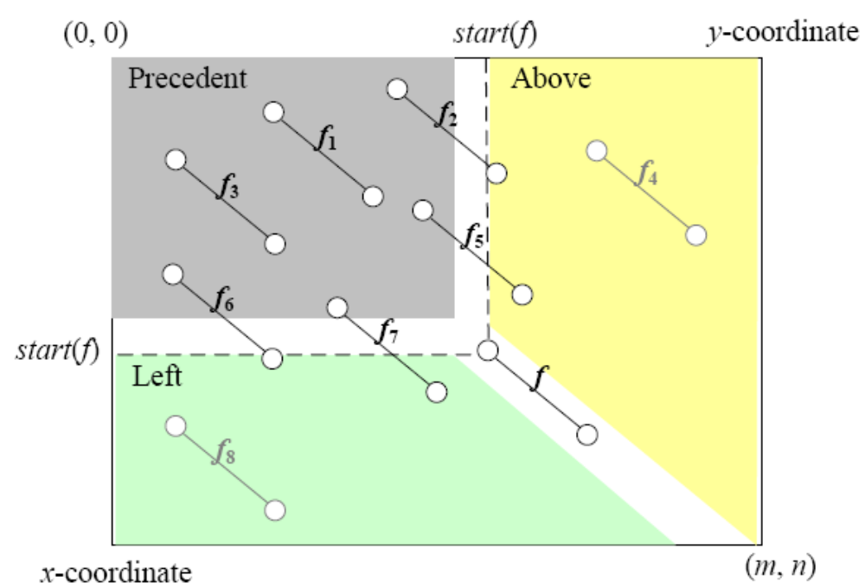
Relations

Slide 9
Example(1)

Slide 10
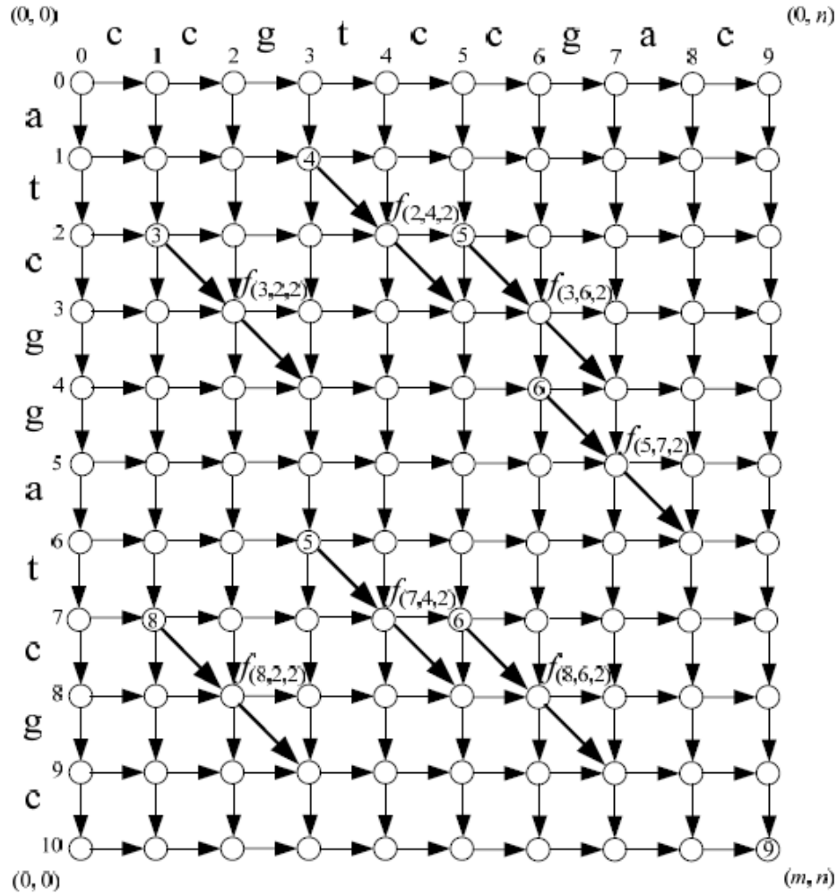
Example(2)

Slide 11
Example(3)
visl(f(3, 6, 2))=f(2, 4, 2), visl(f(5, 7, 2))=f(3, 2, 2), visa(f(5, 7, 2))=f(3, 6, 2), visa(f(7, 4, 2))=f(3, 2, 2), visl(f(8, 6, 2))=f(7, 4, 2) and visa(f(8, 7, 2))=f(2, 4, 2)

Slide 12
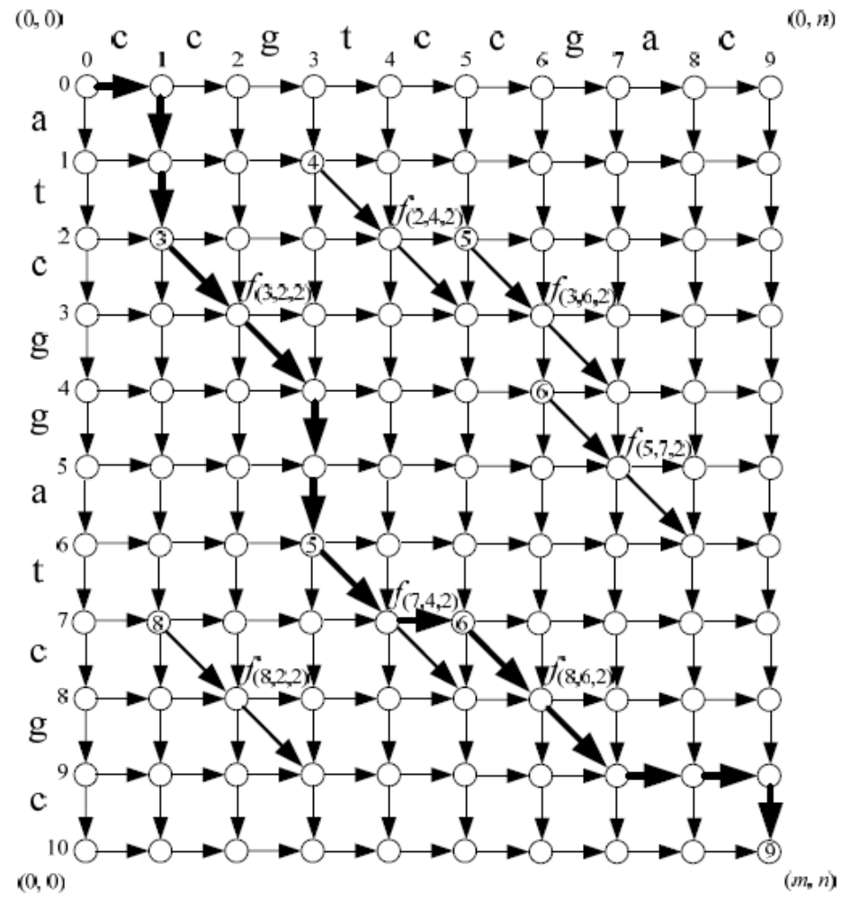
Example(4)

Slide 13
The A* algorithm
Used to solve optimization problems.
Using the best-first strategy.
If a feasible solution (goal node) is obtained, then it is optimal and we can stop.
Cost function of node n : f(n)
f(n) = g(n) + h(n)
g(n): cost from root to node n.
h(n): estimated cost from node n to a goal node.
h*(n): “real” cost from node n to a goal node.
If we guarantee h(n) ≤ h*(n), then
f(n) = g(n) + h(n) ≤ g(n)+h*(n) = f*(n)

Slide 14
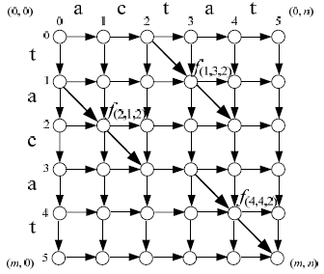
Example(1)

Slide 15
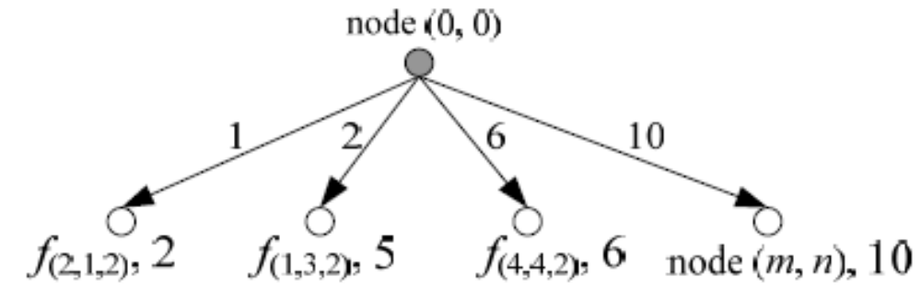
Example(2)

Slide 16
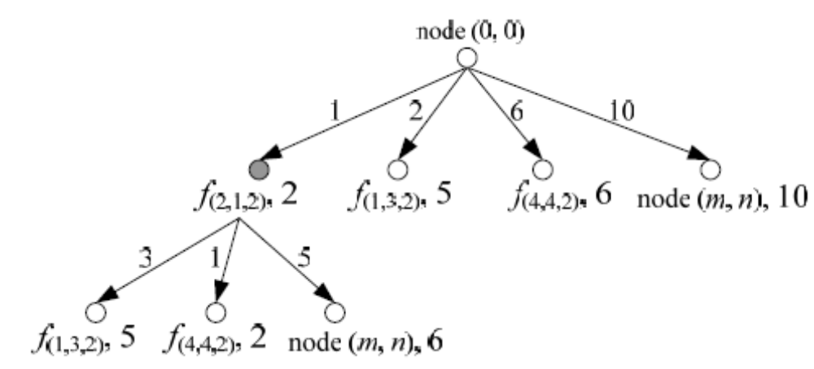
Example(3)

Slide 17
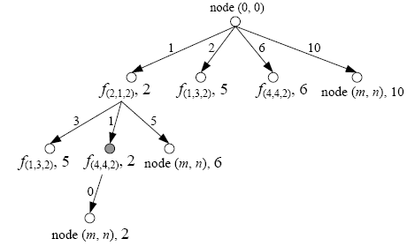
Example(3)

Slide 18
Domination Relation
For two fragments f and f ‘, f ‘ is dominated by f, if x(end(f ‘)) > x(end(f)) and y(end(f ‘)) > y(end(f)).
Only Consider those dominated.

Slide 19
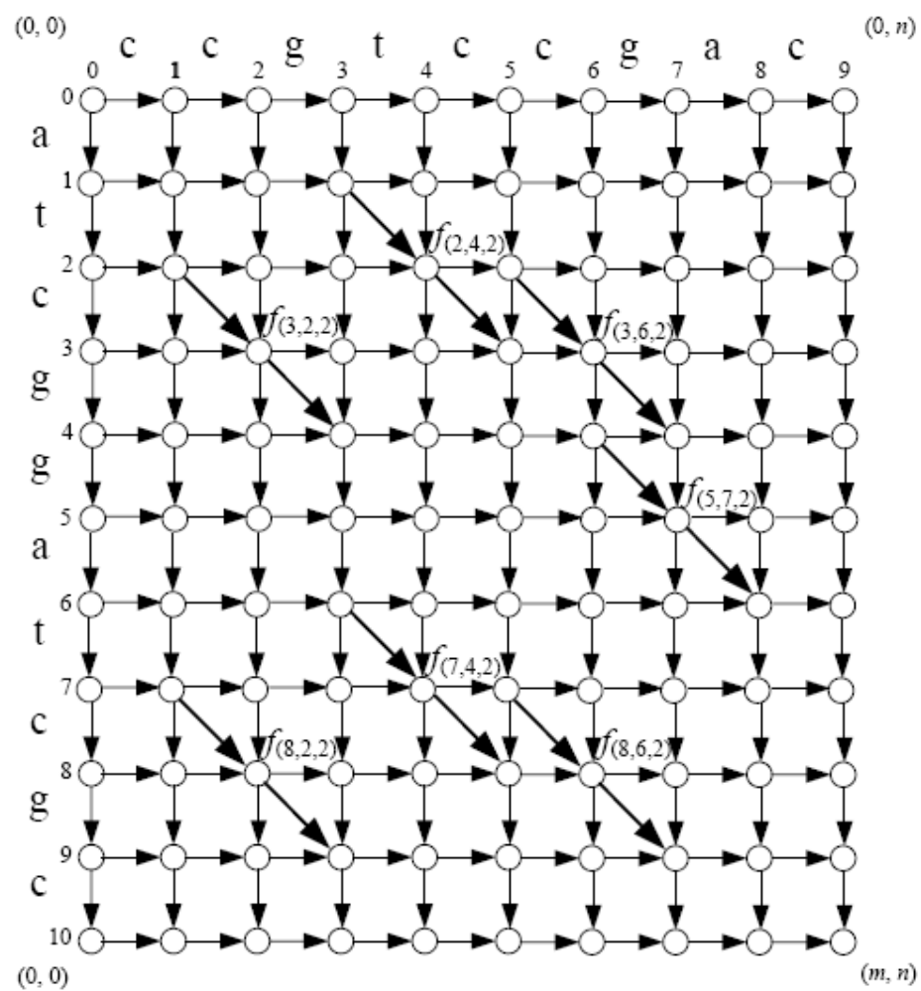
Example2(1)

Slide 20
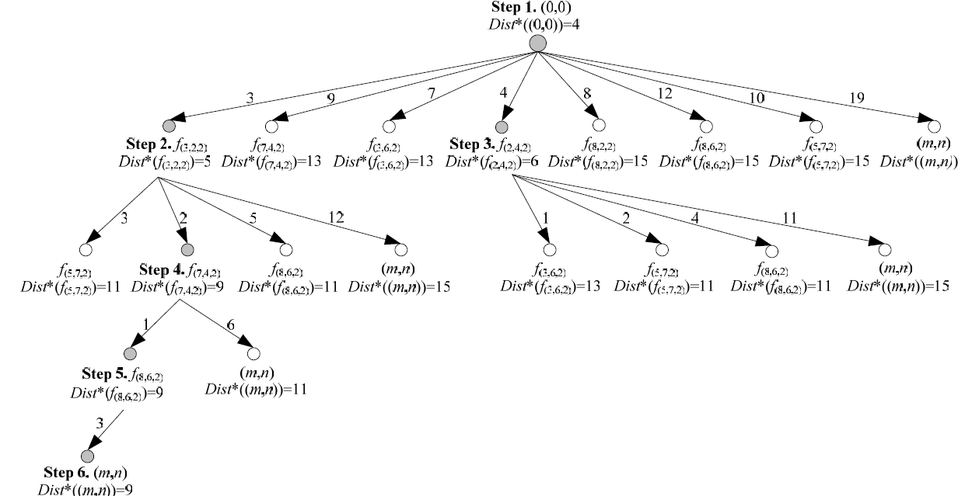
Example2(2)

